Slide 1
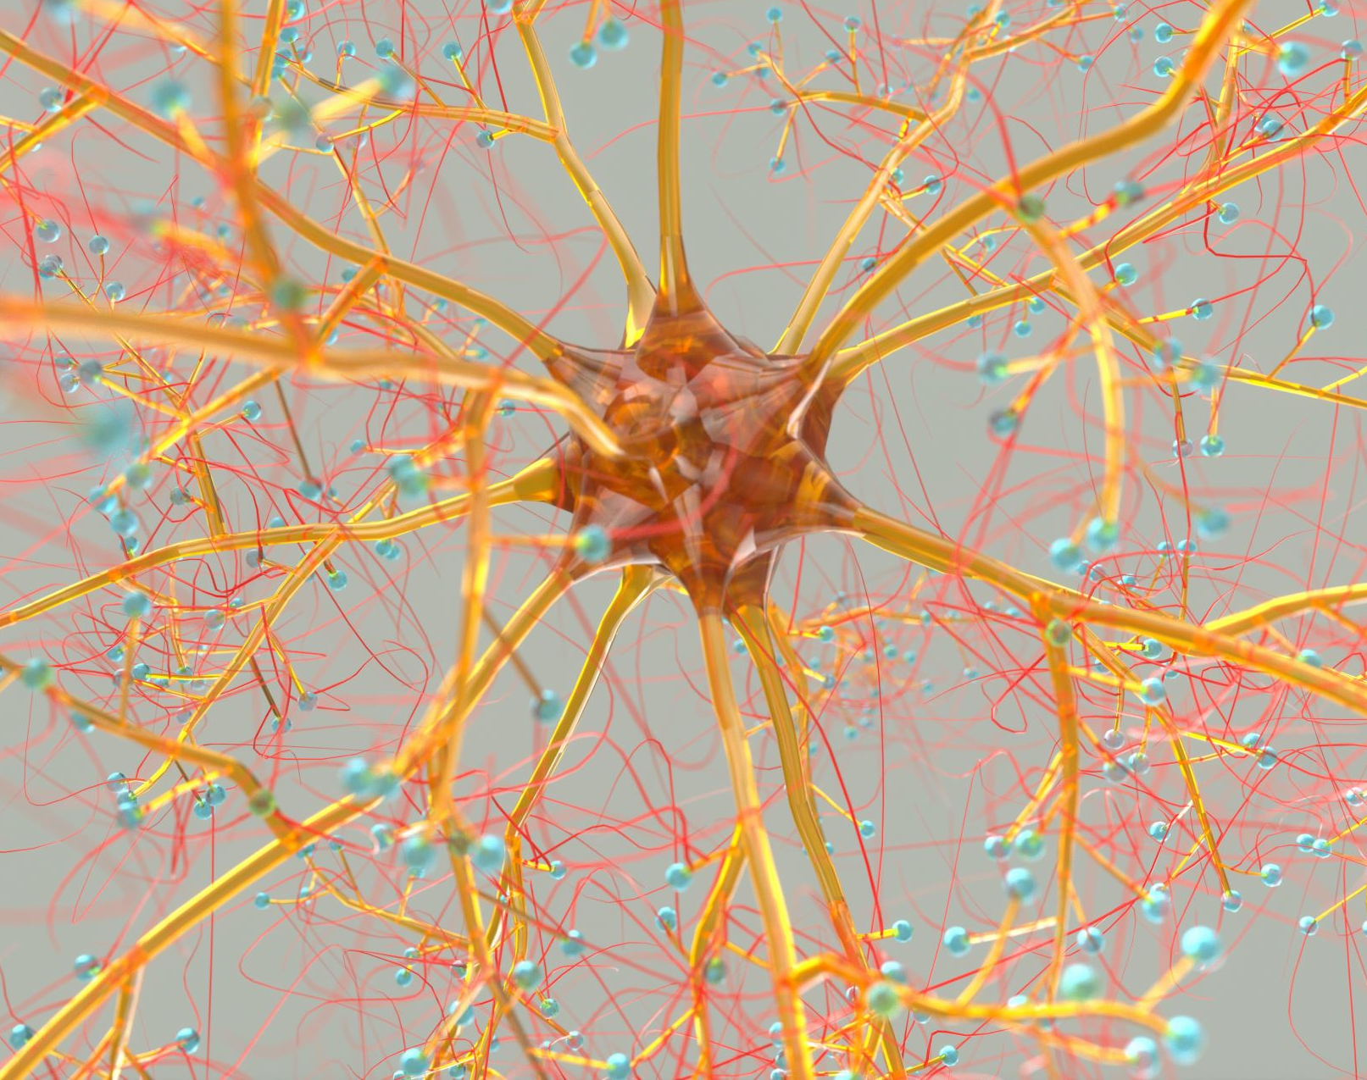
SEP 769 Cyber-Physical Systems Deep Learning
Instructor: Dr. Anwar Majid Mirza
mirzaa24@mcmaster.ca
Lecture No. 1

Slide 2
What is Deep Leaning?
Artificial Intelligence
Deep learning is a subset of machine learning (which in turn is a part of the field of Artificial Intelligence).
Uses Artificial Neural Networks with multiple layers to model and solve complex problems
Machine Learning
Deep Learning
Notes:
Deep learning is a subset of machine learning that uses artificial neural networks with multiple layers to model and solve complex problems. These neural networks are designed to learn and make predictions by processing large amounts of data, without being explicitly programmed for specific tasks.
Deep learning has revolutionized many fields, including computer vision, natural language processing, speech recognition, and robotics. It has enabled machines to perform tasks that were previously impossible, such as image and speech recognition, language translation, and self-driving cars.
Deep learning algorithms are capable of learning features from raw data and extracting high-level representations that capture the underlying patterns and relationships in the data. The success of deep learning is largely due to its ability to scale with large amounts of data, computing power, and advanced algorithms such as convolutional neural networks (CNNs) and recurrent neural networks (RNNs)

Slide 3
AI, Machine Learning and Deep Learning
Ability to learn without being explicitly programmed
AI
Machine Learning
Deep Learning
Learning based on deep neural networks
Science & Engineering of making intelligent machines and programs
Building artificial systems
that process, perceive
and reason about data.

Slide 4
A Brief History of AI / Machine Learning / Deep Learning
1943: Warren McCulloch and Walter Pitts propose the first model of artificial neural networks (ANNs), which were inspired by the structure of the human brain.
1957: Frank Rosenblatt introduces the perceptron, a single-layer neural network capable of learning simple linear patterns.
1969: Marvin Minsky and Seymour Papert publish "Perceptrons," a book that shows the limitations of the perceptron and argues that Neural Networks are fundamentally limited in what they can learn.
1986: Geoffrey Hinton, David Rumelhart, and Ronald Williams publish a paper on the backpropagation algorithm, which enables efficient training of multi-layer neural networks.
1990s: Neural Networks fall out of favor due to difficulties in training them and the rise of other Machine Learning techniques such as Support Vector Machines (SVMs). AI Winter
2006: Hinton, along with Yoshua Bengio and Yann LeCun, pioneers the use of Deep Neural Networks for speech recognition, achieving a significant reduction in error rates.
(This trio is known as Godfathers of Deep Leaning)

Slide 5
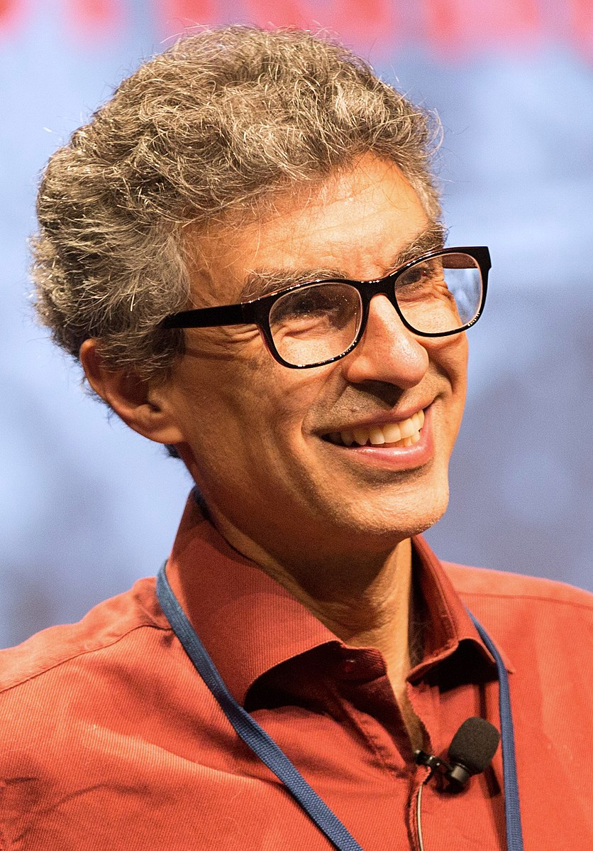
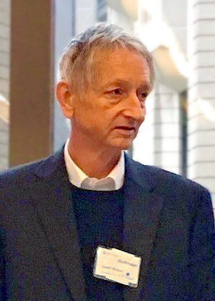

A Brief History of AI / Machine Learning / Deep Learning
Yoshua Bengio
Geoffrey Hinton
Yann LeCun

Slide 6
A Brief History of AI / Machine Learning / Deep Learning …
2012: Alex Krizhevsky, Ilya Sutskever, and Hinton use Deep Convolutional Neural Networks (CNNs) to win the ImageNet Large Scale Visual Recognition Challenge, dramatically improving image recognition accuracy. LeNet, AlexNet, and Microsoft’s Very Deep Net.
2014: Google acquires DeepMind, an AI research company founded by Demis Hassabis, Shane Legg, and Mustafa Suleyman, which goes on to make significant breakthroughs in Reinforcement Learning.
2015: Andrej Karpathy uses Recurrent Neural Networks to generate image captions, showing the potential of Deep Learning for Natural Language Processing (NLP).
2016: AlphaGo, a program developed by DeepMind, defeats the world champion in the game of Go, demonstrating the power of Deep Learning for complex decision-making.
2018: Hinton, Bengio, and LeCun receive the Turing Award (referred to as the Nobel Prize of Computing), the highest honor in computer science, for their contributions to Deep Learning.
2024: John J. Hopfield and Geoffrey Hinton were awarded the Nobel Prize in Physics, “for foundational discoveries and inventions that enable machine learning with artificial neural networks”.

Slide 7
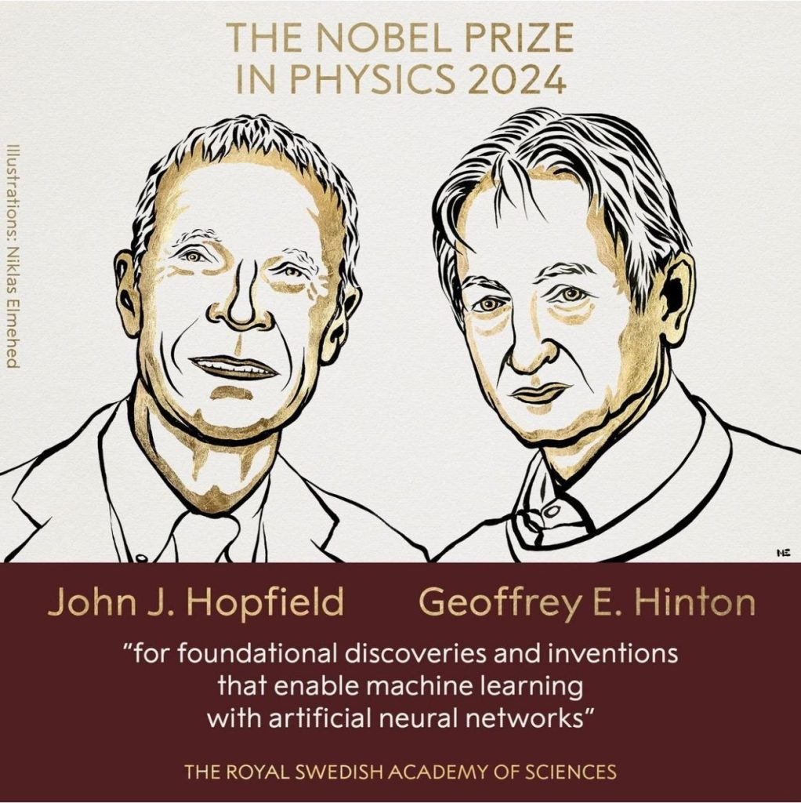

Slide 8
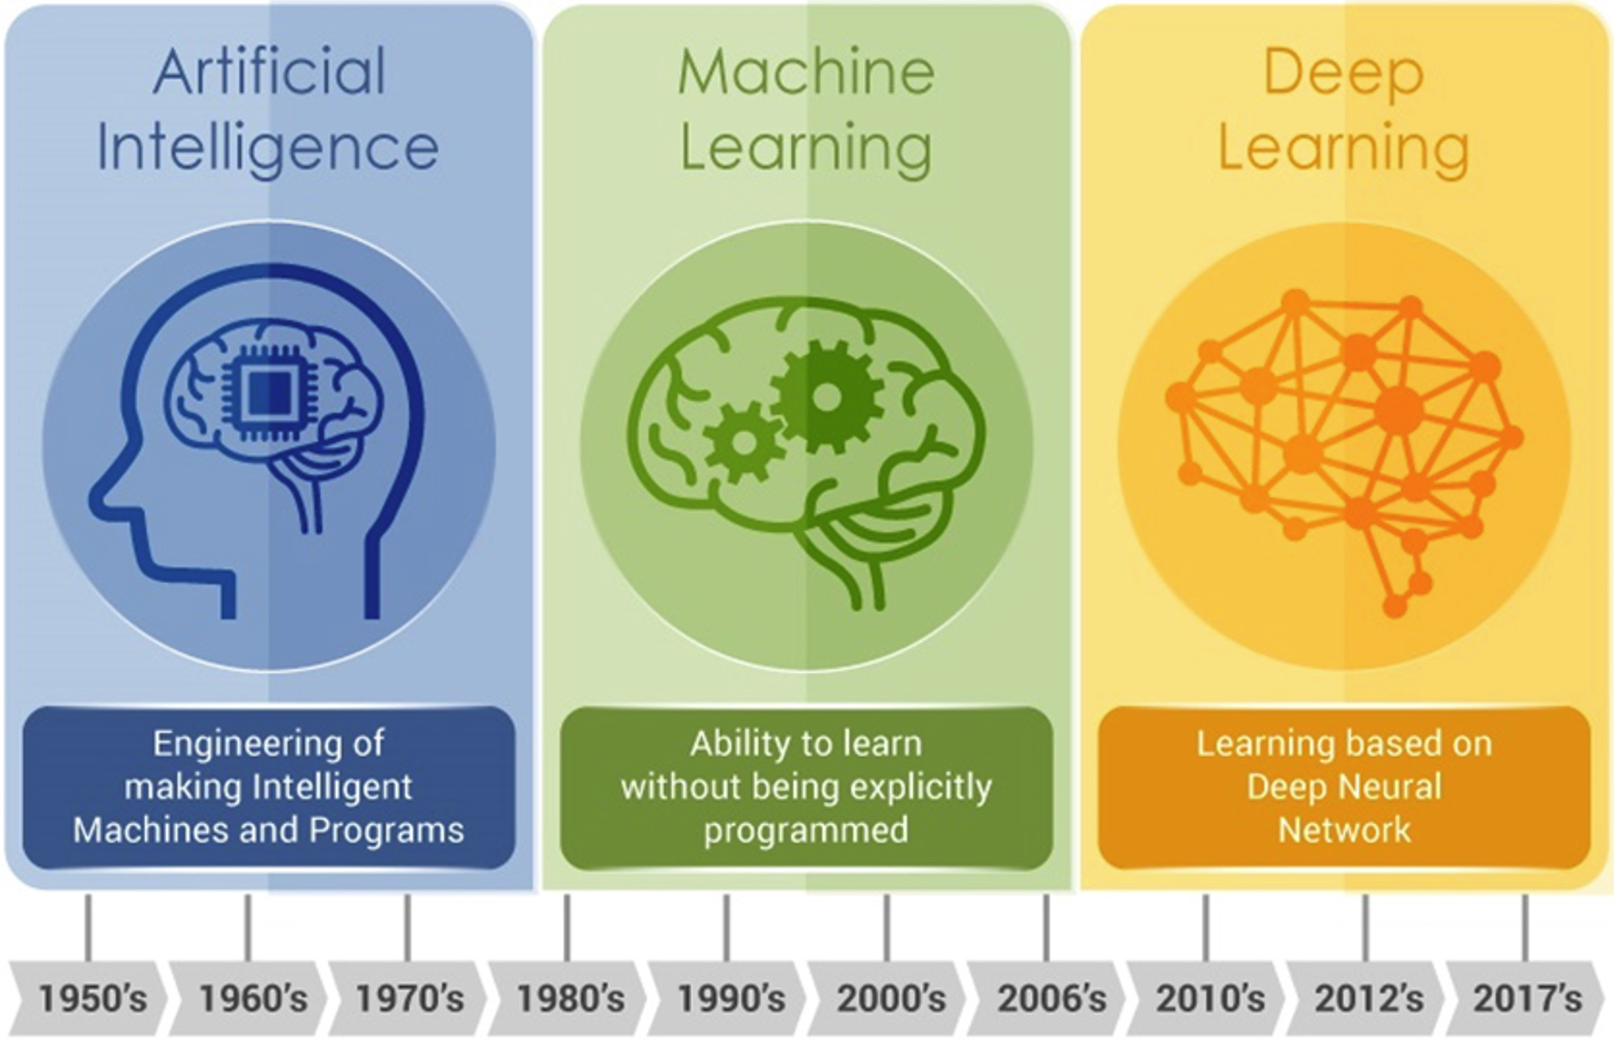
Brief History

Slide 9
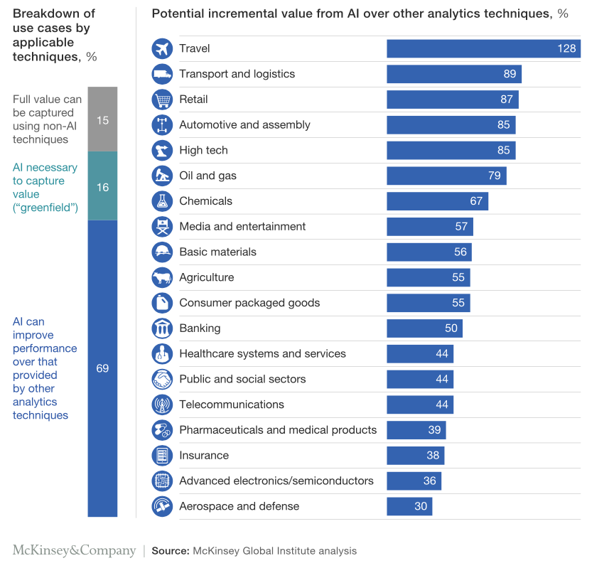
AI versus Other Analytics Techniques McKinsey 2018
Click here for the link.
Notes:
Deep learning is a subset of machine learning that uses artificial neural networks with multiple layers to model and solve complex problems. These neural networks are designed to learn and make predictions by processing large amounts of data, without being explicitly programmed for specific tasks.
Deep learning has revolutionized many fields, including computer vision, natural language processing, speech recognition, and robotics. It has enabled machines to perform tasks that were previously impossible, such as image and speech recognition, language translation, and self-driving cars.
Deep learning algorithms are capable of learning features from raw data and extracting high-level representations that capture the underlying patterns and relationships in the data. The success of deep learning is largely due to its ability to scale with large amounts of data, computing power, and advanced algorithms such as convolutional neural networks (CNNs) and recurrent neural networks (RNNs)

Slide 10
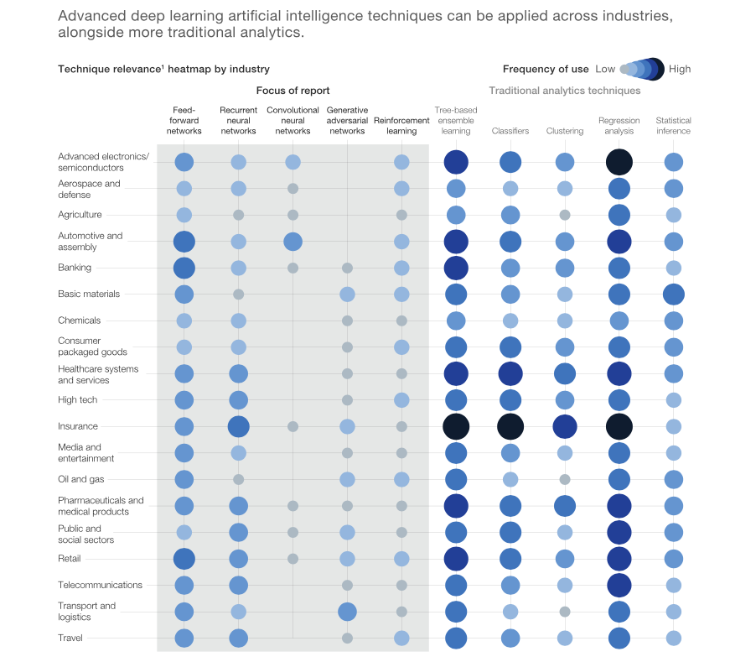
Insights from 400 use cases across 19 industries McKinsey 2018
Click here for the link.
Notes:
Deep learning is a subset of machine learning that uses artificial neural networks with multiple layers to model and solve complex problems. These neural networks are designed to learn and make predictions by processing large amounts of data, without being explicitly programmed for specific tasks.
Deep learning has revolutionized many fields, including computer vision, natural language processing, speech recognition, and robotics. It has enabled machines to perform tasks that were previously impossible, such as image and speech recognition, language translation, and self-driving cars.
Deep learning algorithms are capable of learning features from raw data and extracting high-level representations that capture the underlying patterns and relationships in the data. The success of deep learning is largely due to its ability to scale with large amounts of data, computing power, and advanced algorithms such as convolutional neural networks (CNNs) and recurrent neural networks (RNNs)

Slide 11
What Are The Most Important Areas of Deep Learning?
Neural Networks and Deep Leaning Fundamentals
Feedforward Neural Networks (FNNs)
Recurrent Neural Networks (RNNs)
Convolutional Neural Networks (CNNs)
Reinforcement Learning (RL)
Deep Learning Frameworks
Applications of Deep Learning
Advanced Deep Learning Topics
Notes:
Here are six important areas that needs to be covered in a course on deep learning:
Neural Networks and Deep Learning Fundamentals: It is essential to cover the basics of neural networks and their architecture, activation functions, gradient descent optimization, and backpropagation algorithms. This will provide a foundation for understanding deep learning models.
Convolutional Neural Networks (CNNs): CNNs are a type of neural network used for image recognition and processing tasks. It is crucial to cover their architecture, pooling, and convolution operations, and how to use them for object detection, image classification, and image segmentation.
Recurrent Neural Networks (RNNs): RNNs are another type of neural network used for sequential data, such as time-series data and natural language processing. It is essential to cover their architecture, long-short term memory (LSTM), and gated recurrent units (GRUs), and how to use them for tasks such as speech recognition, text generation, and sentiment analysis.
Deep Learning Frameworks: Covering popular deep learning frameworks such as TensorFlow, PyTorch, and Keras is crucial as they provide high-level APIs to create, train and evaluate deep learning models.
Applications of Deep Learning: It is important to cover some practical applications of deep learning in different fields such as computer vision, natural language processing, speech recognition, and robotics.
Advanced Deep Learning Topics: Advanced topics such as generative adversarial networks (GANs), transfer learning, reinforcement learning, and attention mechanisms should also be covered to provide a comprehensive understanding of deep learning.

Slide 12
What Are The Most Important Things to Learn / Study in Becoming an Expert of Deep Learning?
Mathematics
Programming
Neural Networks
Model Design and Evaluation
Data Preparation and Presentation
Research and Innovation
Optimization Techniques
Computer Vision
Natural Language Processing
Transfer Learning
Collaborative and Open-Source Tools
Communication Skills
Notes:
Becoming an expert in deep learning requires continuous learning and staying up-to-date with the latest research and developments in the field. Here are some important things to learn and study to become an expert in deep learning:
Mathematics: Deep learning relies heavily on mathematical concepts such as linear algebra, calculus, probability theory, and optimization. Understanding these mathematical concepts is essential to design and optimize deep learning models.
Programming: Expertise in programming languages such as Python and knowledge of deep learning libraries such as TensorFlow, PyTorch, and Keras is essential to develop and implement deep learning models.
Neural Networks: A deep understanding of neural networks and their architecture, activation functions, and optimization algorithms is critical to building effective deep learning models.
Model Design and Evaluation: Deep learning experts must be skilled in designing and evaluating models for various tasks such as image classification, object detection, natural language processing, and speech recognition.
Data Preparation: A deep learning model is only as good as the data it is trained on. Therefore, experts must be proficient in data preprocessing techniques such as data cleaning, normalization, and augmentation.
Research and Innovation: Staying up-to-date with the latest research and developments in the field and contributing to the deep learning community through innovative ideas and research is crucial to becoming an expert in deep learning.
Optimization Techniques: Deep learning models typically require a large amount of data and computation power to train effectively. Therefore, experts in deep learning must be familiar with various optimization techniques such as stochastic gradient descent, momentum, adaptive learning rate methods, and regularization techniques.
Computer Vision: Understanding computer vision concepts such as image processing, feature extraction, and object recognition is essential for designing effective deep learning models for computer vision tasks.
Natural Language Processing: NLP is another important area where deep learning is extensively used. Deep learning experts must be familiar with NLP concepts such as text preprocessing, feature extraction, and language modeling.
Transfer Learning: Transfer learning is a popular technique used in deep learning, where pre-trained models are used as a starting point for a new task. Expertise in transfer learning is crucial to save time and resources while building deep learning models.
Collaborative and Open-Source Tools: Deep learning experts should be familiar with various collaborative and open-source tools such as GitHub, GitLab, and Bitbucket, which allow them to share their code and collaborate with other deep learning experts.
Communication Skills: Deep learning experts must be able to communicate complex technical concepts to non-technical stakeholders effectively. They should also be able to explain their models and results to a broader audience, such as clients or business leaders.
In summary, becoming an expert in deep learning requires a combination of technical skills, continuous learning, and staying up-to-date with the latest research and developments in the field.
Becoming an expert in deep learning is a continuous process, and it requires a lot of dedication, hard work, and persistence. In addition to technical skills, experts in deep learning should also have a curious and analytical mindset, a passion for learning, and the ability to solve complex problems creatively.
Moreover, the deep learning field is constantly evolving, and staying updated with the latest research, techniques, and tools is crucial. Deep learning experts should be willing to invest time in self-learning, reading research papers, participating in online forums, attending conferences and workshops, and collaborating with other experts in the field.
Finally, ethical considerations in deep learning must not be overlooked. Deep learning models are increasingly being used to make important decisions in various domains, such as finance, healthcare, and criminal justice. Therefore, experts in deep learning should be aware of ethical considerations, such as fairness, accountability, and transparency, and ensure that their models do not cause harm or perpetuate bias.

Slide 13
Remaining Lecture ...
Introduction
What is a Neural Network?
Mathematical Model of a Neuron
Network Architectures
Training
Commonly Used Activation Functions
Typical Problem Areas
Perceptron: Simple Perceptron for Pattern Classification
Perceptron: Algorithm
Perceptron: Example
A Perceptron to classify letters from different fonts:
One Output Class
A Perceptron to classify letters from different fonts:
Several output classes
Modified Perceptron Algorithm
Problem with Perceptron Learning
Derivation of Delta-Rule
Single output unit case
Multiple output units’ case
Application of Delta Rule:
Adaline
Tools: Practice Session
Download Jupyter Notebook “adaline.ipynb” from A2L course website and run it on Anaconda / CoLab

Slide 14
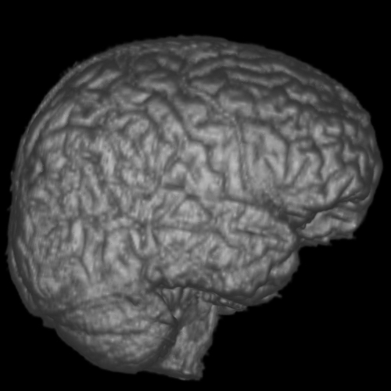
Welcome to the World of
Artificial Neural Networks
Brain
A marvelous piece of architecture and design.
In association with a nervous system, it controls the life patterns, communications, interactions, growth and development of hundreds of billion of life forms.

Slide 15
Some Statistics
There are about 10¹⁰ to 10¹⁴ nerve cells (called neurons) in an adult human brain.
Neurons are highly connected with each other. Each nerve cell is connected to hundreds of thousands of other nerve cells.
Passage of information between neurons is slow (in comparison to transistors in an IC). It takes place in the form of electrochemical signals between two neurons in milliseconds.
Energy consumption per neuron is low (approximately 10⁻⁶ Watts).

Slide 16

How do the actual
neurons look like?
Look more like some
blobs of ink… aren’t they!
Taking a more closer look
reveals that there is a
large collection of different
molecules, working together
coherently, in an organized
manner.
Put together, they form the
best information processing
system in the known universe.

Slide 17
Salient Features of a Neuron
Mind you, a neuron is a 3Dentity!
Nucleus
Axon
Synapse
Axons from
another
neurons
Cell Body
Synapse
Dendrites

Slide 18
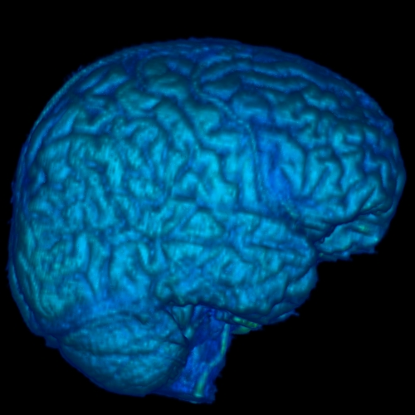
Information Processing in a Neural Network
Flow of Information
A few Neurons and their synaptic junctions

Slide 19
Mathematical Model of
A Typical Neuron
Mathematical Model of
A Typical Neuron
Gain₁
Gain₂
+1
Input
Lines
∑
(+1 or –1)
–1
Output
. . .
Gain_{n}
Bias
Gain
+1
Gains are adjustable

Slide 20
Basics of an Artificial Neural Network
An artificial neural network is an information processing system that has certain performance characteristics in common with biological neural networks.
An ANN can be characterized by:
Architecture: The pattern of connections between different neurons.
Training or Learning Algorithms: The method of determining weights on the connections.
Activation Function: The nature of function used by a neuron to become activated.

Slide 21
Architecture
There are two basic categories:
Feed-forward Neural Networks
These are the nets in which the signals flow from the input units to the output units, in a forward direction.
They are further classified as:
Single Layer Nets
Multi-layer Nets
Recurrent Neural Networks
These are the nets in which the signals can flow in both directions from the input to the output or vice versa.

Slide 22
w₁₁
X₁
Y₁
w₂₁
w₃₁
w₁₂
X₂
Y₂
w₂₂
Model 1: A Single Layer Net
l
l
l
w₃₂
l
l
l
X_{n}
w₁₃
Y_{m}
w_{2m}
w_{nm}
Input
Units
Output
Units

Slide 23

Model 2: A Multi-Layer Net
X₁
w₁₁
v₁₁
Y₁
w_{i1}
Z₁
v_{j1}
l
l
l
w_{n1}
v_{p1}
l
l
l
l
l
l
w_{1j}
v_{1k}
X_{i}
Z_{j}
Y_{k}
w_{ij}
v_{jk}
w_{nj}
l
l
l
v_{pk}
l
l
l
l
l
l
w_{1p}
v_{1m}
Z_{p}
Biological
Neurons
In Action
X_{n}
w_{ip}
v_{jm}
Y_{m}
w_{np}
v_{pm}
Input
Units
Hidden
Units
Output
Units

Slide 24
Model 3: A Recurrent Net
1
w₁₁
1
X₁
Y₁
w_{1n}
v_{1n}
v_{1m}
w_{1m}
X_{n}
Y_{m}
w_{nm}
1
1

Slide 25
Training
Supervised Training
Training is accomplished by presenting a sequence of training vectors or patterns, each with an associated target output vector.
The weights are then adjusted according to a learning algorithm.
During training, the network develops an associative memory. It can then recall a stored pattern when it is given an input vector that is sufficiently similar to a vector it has learned.
Unsupervised Training
A sequence of input vectors is provided, but no traget vectors are specified in this case.
The net modifies its weights and biases, so that the most similar input vectors are assigned to the same output unit.

Slide 26
Common Activation Functions
1. Binary Step Function
(a “threshold” or “Heaviside” function)
2. Bipolar Step Function
3. Binary Sigmoid
Function (Logistic
Sigmoid)
3. Bipolar Sigmoid
4. Hyperbolic -
Tangent

Slide 27
Typical Problem Areas
The number of application areas in which artificial neural networks are used is growing daily.
Some of the representative problem areas, where neural networks have been used are:
Pattern Completion: ANNs can be trained on a set of visual patterns represented by pixel values.
If subsequently, a part of an individual pattern (or a noisy pattern) is presented to the network, we can allow the network’s activation to propagate through the net till it converges to the original (memorized) visual pattern.
The network is acting like a “content- addressable” memory.

Slide 28
Typical Problem Areas
Classification: An early example of this type of network was trained to differentiate between male and female faces.
It is actually very difficult to create an algorithm to do so yet, but an ANN has shown to have near-human capacity to do so.
Optimization: It is notoriously difficult to find algorithms for solving optimization problems (e.g., TSP).
There are several types of neural networks which have been shown to converge to ‘good-enough’ solutions i.e., solutions which may not be globally optimal but can be shown to be close to the global optimum for any given set of parameters.

Slide 29
Typical Problem Areas
Feature Detection: An early example of this is the phoneme producing feature map of Kohonen:
The network is provided with a set of inputs and must learn to pronounce the words; in doing so, it must identify a set of features which are important in phoneme production
Data Compression: There are many ANNs which have been shown to be capable of representing input data in a compressed format loosing as little of the information as possible.
Approximation: Given examples of an input to output mapping, a neural network can be trained to approximate the mapping so that a future input will give approximately the correct answer i.e., the answer which the mapping should give.

Slide 30
Typical Problem Areas
Association: We may associate a particular input with a particular output so that given the same (or similar) input again, the net will give the same (or a similar) output again.
Prediction: This task may be stated as: given a set of previous examples from a time series, such as a set of closing prices of a Stock Exchange, to predict the next (future) sample.
Control: For example, to control the movement of a robot arm (or truck, or any non-linear process) to learn what inputs (actions) will have the correct outputs (results)

Slide 31
Perceptron
Perceptrons had perhaps the most far-reaching impact of any of the early neural nets.
A number of different types of Perceptrons have been used and described by various workers.
The original perceptrons had three layers of neurons – sensory units, associator units and a response unit – forming an approximate model of a retina.
Under suitable assumptions, its iterative learning procedure can be proved to converge to the correct weights i.e., the weights that allow the net to produce the correct output value for each of the training input patterns.

Slide 32
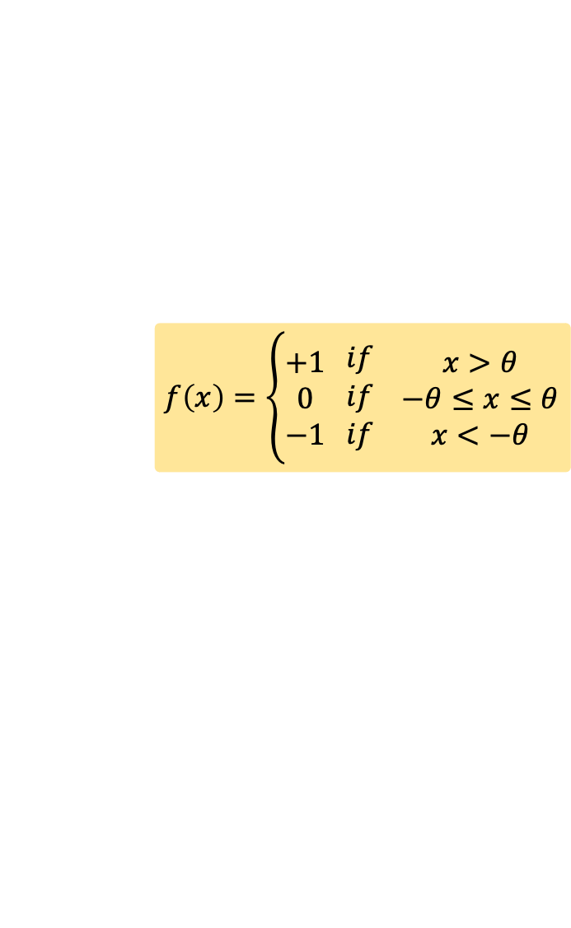
Simple Perceptron for Pattern Classification
The architecture of a simple perceptron for performing single classification is shown in the figure.
The goal of the net is to classify each input pattern as belonging, or not belonging, to a particular class.
Belonging is signified by the output unit giving a response of +1; not belonging is indicated by a response of -1.
A zero output means that it is not decisive.
1
X₁
b
w₁
X₂
w₂
Y
l
l
l
w_{n}
X_{n}
$$f\left(x\right)=\left\{\begin{matrix}+1 \\ 0 \\ −1\end{matrix} \begin{matrix}if \\ if \\ if\end{matrix} \begin{matrix}x>θ \\ −θ≤x≤θ \\ x<−θ\end{matrix}\right.$$

Slide 33

Perceptron: Algorithm
Initialize weights, bias and the threshold $θ$. Also set the learning rate $α$ such that ($0<α≤1$).
While stopping condition is false, do the following steps.
For each training pair s:t, do steps 4 to 7.
Set the activations of input units. x_{i} = s_{i}
Compute the response of the output unit.
Update weights and bias if an error occurred for this pattern.
If y is not equal to t (under some limit) then
w_{i}(new) = w_{i}(old) + $α$ x_{i} t for i = 1 to n
b(new) = b(old) + $α$ t
end if
Test stopping condition: If no weight changed in step 3, stop, else continue.

Slide 34
Perceptron: Example
Lets consider the following training data:
Inputs Target
x₁ x₂ t
1 1 1
1 0 -1
0 1 -1
0 0 -1
We initialize the weights to be w₁ = 0, w₂ = 0 and b = 0. Also, we set α = 1, and θ = 0.2.
The following table shows the sequence in which the net is provided with the input one by one and checked for the required target.

Slide 35
Perceptron: Example
Input
Bias
Net
Input
Output
Target
Weights
x₁
x₂
y_{in}
y
t
w₁
w₂
b
1
0
0
0
1
1
1
0
0
1
1
1
1
1
0
1
2
1
-1
0
1
0
0
1
1
1
1
-1
0
0
-1
0
0
1
-1
-1
-1
0
0
-1
2
1
1
1
-1
-1
1
1
1
0
1
0
1
1
1
-1
0
1
-1
0
1
1
0
0
-1
0
0
-2
0
0
1
-2
-1
-1
0
0
-2

Slide 36
Perceptron: Example
Input
Bias
Net
Input
Output
Target
Weights
x₁
x₂
y_{in}
y
t
w₁
w₂
b
10
1
1
1
1
1
1
2
3
-4
1
0
1
-2
-1
-1
2
3
-4
0
1
1
-1
-1
-1
2
3
-4
0
0
1
-4
-1
-1
2
3
-4
Thus, the positive response is given by all the points
such that
And the negative response is given by all the points
such that

Slide 37
Decision Boundaries
We note that the output of the Perceptron is 1(positive), if the net input ‘y_{in}’ is greater than θ.
Also that the output is -1(negative), if the net input ‘y_{in}’ is less than –θ.
We also know that
y_{in} = b + x₁*w₁ + x₂*w₂
in this case
Thus, we have
2*x₁ + 3*x₂ – 4 > 0.2 (+ve output)
2*x₁ + 3*x₂ – 4 < -0.2 (-ve output)
Removing the inequalities and simplifying them gives us the following two equations:
2*x₁ + 3*x₂ = 4.2
2*x₁ + 3*x₂ = 3.8

Slide 38
Decision Boundaries
These two equations are equations of straight lines in x1,x2-plane.
These lines geometrically separate out the input training data into two classes.
Hence, they serve as acting like decision boundaries.
The two lines have the same slope, but their y-intercepts are different. So essentially, we have two parallel straight lines acting line decision boundaries for out input data.
The parameter θ, determines the separation between two lines (and hence the width of the indecisive region).

Slide 39
Perceptron: Example
Graphically
x₂
(0, 1)
(1, 1)
x₁
(0, 0)
(1, 0)
Undecided
Region

Slide 40


A Perceptron to classify letters from
different fonts: one output class
1
0
Input from
Font 1
$s_{1}=$[$\begin{aligned}−1, −1, +1,+1,−1,−1, −1, \\ −1, −1, −1, +1, −1, −1, −1, \\ −1,−1,−1,+1,−1,−1,−1, \\ −1,−1,+1,−1,+1,−1,−1, \\ −1,−1,+1,−1,+1,−1,−1, \\ −1,+1,+1,+1,+1,+1,−1, \\ −1,+1,−1,−1,−1,+1,−1, \\ −1,+1,−1,−1,−1,+1,−1, \\ +1,+1,−1,−1,−1,+1,+1\end{aligned}$]
$t_{1}=$[$\begin{aligned}+1, \\ −1, \\ −1, \\ −1, \\ −1, \\ −1, \\ −1, \\ −1, \\ −1\end{aligned}$]

Slide 41
A Perceptron to classify letters from
different fonts: one output class
Input from
Font 2
1
0

Slide 42
A Perceptron to classify letters from
different fonts: one output class
Input from
Font 3
1
0

Slide 43
A Perceptron to classify letters from
different fonts: one output class
Consider the 21 input patterns as shown on the last three slides.
Let us first assume that we want to train a simple perceptron to classify each of the above input patterns as belonging, or not belonging to the class A (letters which are very similar to A).
In that case, the target value for each pattern is either +1 or -1. There are three examples of A and 18 examples of not-A in last three slides.
We could, of course, use the same vectors as examples of B or not-B and train the net in a similar way.
Note, however, that because we are using a single layer net, the weights for the output unit signifying A, do not have any interaction with the weights for the output unit signifying B.

Slide 44
A Perceptron to classify letters from
different fonts: one output class
Therefore, we can solve these problems at the same time, by allowing a column of weights for each output unit.
Our net would have 63 input units and 2 output units.
The first output unit would correspond to “A” or “not-A”, the second unit to “B” or “not-B”.
Continuing this idea, we can identify 7 output units, one for each of the 7 categories into which we wish to classify out input.

Slide 45






A Perceptron to classify letters from
different fonts: several output classes
The simple perceptron discussed so far, can be extended easily to the case where the input vectors belong to the one (or more) of several categories to which the input vectors may belong.
The architecture of such a net is shown in the figure.
1
w₁₁
b₁
X₁
Y₁
w₂₁
w_{n1}
1
b₂
w₁₂
Net Inputs
$$y_{1_in}=b_{1}+w_{11}x_{1}+w_{21}x_{2}…+w_{n1}x_{n}$$
$$y_{2_in}=b_{2}+w_{12}x_{1}+w_{22}x_{2}…+w_{n2}x_{n}$$
$$⋮$$
$$y_{m_in}=b_{m}+w_{1m}x_{1}+w_{2m}x_{2}…+w_{nm}x_{n}$$
X₂
Y₂
w₂₂
l
l
l
w_{n2}
l
l
l
$\left[\begin{matrix}\begin{matrix}y_{1_in} \\ y_{2_in}\end{matrix} \\ \begin{matrix}⋮ \\ y_{m_in}\end{matrix}\end{matrix}\right]$ =
$$\left[\begin{matrix}\begin{matrix}b_{1} \\ b_{2}\end{matrix} \\ \begin{matrix}⋮ \\ b_{m}\end{matrix}\end{matrix}\right] +$$
$$\left[\begin{matrix}\begin{matrix}w_{11} & w_{21} & … \\ w_{12} & w_{22} & … \\ ⋮ & ⋮ & ⋱\end{matrix} & \begin{matrix}w_{n1} \\ w_{n2} \\ ⋮\end{matrix} \\ \begin{matrix}w_{1m} & w_{2m} & …\end{matrix} & w_{nm}\end{matrix}\right]$$
$$\left[\begin{matrix}\begin{matrix}x_{1} \\ x_{2}\end{matrix} \\ \begin{matrix}⋮ \\ x_{n}\end{matrix}\end{matrix}\right]$$
1
b_{m}
X_{n}
w₁₃
Y_{m}
w_{2m}
$$y_{in}=b+WX$$
w_{nm}

Slide 46
A Perceptron to classify letters from
different fonts: several output classes
For this example, each input vector is a 63-tuple representing a letter expressed as a pattern on a 7x9 grid of pixels.
There are seven categories to which each input vector may belong, so there are seven components to the output vector, each representing a letter: A, B, C, D, E, K or J.
The training input patterns, and target responses must be converted to an appropriate form for the neural net to process.
A bipolar representation has better computational characteristics than does a binary representation.
We would also require a ‘modified training algorithm’ for several output categories. One such algorithm is given on the next slide.

Slide 47

Modified Perceptron Algorithm for Several Output Units
Initialize weights, bias and the threshold θ. Also set the learning rate α such that ( 0 < α <=1).
While stopping condition is false, do the following steps.
For each training pair s:t, do steps 4 to 6.
Set the activations of input units. x_{i} = s_{i}
Compute the response $y_{j}$ of each output unit Yj, j=1,…,m.
Update weights and bias if an error occurred for this pattern for any of the output unit.
If $y_{j}$ is not equal to $t_{j}$ (under some limit) then
$w_{ij}\left(new\right)=w_{i}\left(old\right)+α x_{i} t_{j}$ for $j=1, 2, …, m;i=1, 2, …, n$
$b_{j}\left(new\right)=b_{j}\left(old\right)+αt_{j}$
end if
Test stopping condition: If no weight changed in step 3, stop, else continue.

Slide 48
Problem with Perceptron Learning
The major problem with Perceptron learning is that it cannot separate out those classes which are not linearly separable.
Thus, there is a need to improve upon the existing model and develop a technique which could be useful for a wider range of problems. … Solution to this problem was provided by Widrow’s Delta Rule…
x₂
x₁

Slide 49
Delta Rule
The delta rule changes the weights of the neural network connections so as to minimize the difference between the net input y_{in} (which is considered to be equal to the output ‘y’ in this case) to the output unit and the target value ‘t’.
The aim is to minimize the error over all training patterns. This is accomplished by reducing the error for each pattern one at a time.
Case 1: Single Output Unit
In this case the square of the error for a particular training pattern is:

Slide 50
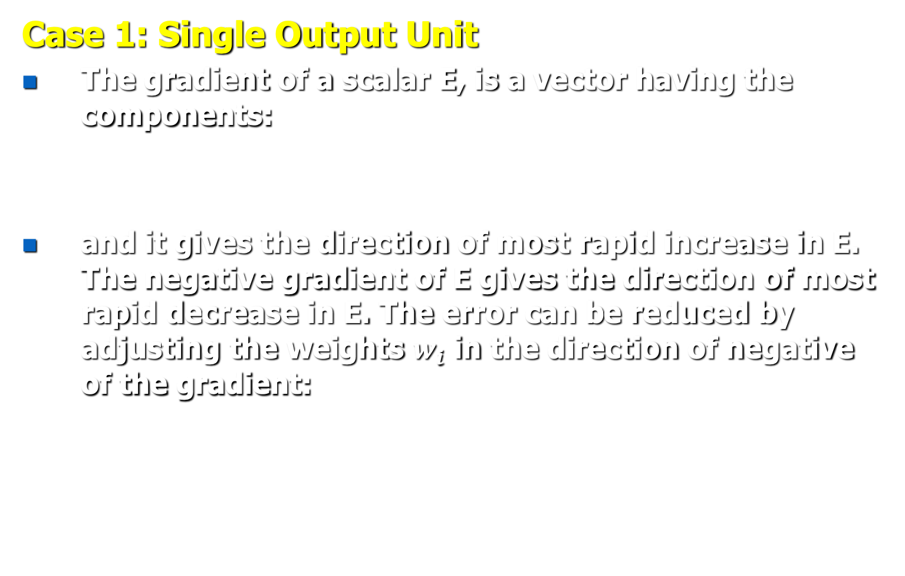

Delta Rule
Case 1: Single Output Unit
The gradient of a scalar E, is a vector having the components:
and it gives the direction of most rapid increase in E. The negative gradient of E gives the direction of most rapid decrease in E. The error can be reduced by adjusting the weights $w_{i}$ in the direction of negative of the gradient:
$$∇E=$$
Gives maximum rate
of change of E

Slide 51
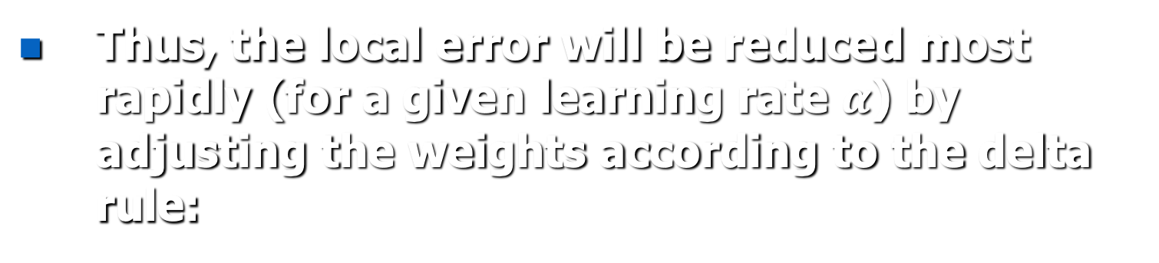
Delta Rule
Thus, the local error will be reduced most rapidly (for a given learning rate $α$) by adjusting the weights according to the delta rule:

Slide 52
Delta Rule
Case 2: Several Output Units
In this case:
Thus, the delta rule for multiple output units' case is:

Slide 53
Adaline: Algorithm
ADALINE stands for ADAptive LInear NEuron.
Initialize weights and bias. Also set the learning rate α such that ( 0 < α <=1).
While stopping condition is false, do the following steps.
For each training pair s:t, do steps 4 to 6.
Set the activations of input units. x_{i} = s_{i}
Compute the response of the output unit.
Update weights and bias if an error occurred for this pattern.
w_{i}(new) = w_{i}(old) + α (t - y_{in})x_{i} for i = 1 to n
b(new) = b(old) + α (t – y_{in})
Test stopping condition: If the largest weight change that occurred in step 2 is smaller than a specified tolerance, then stop; else continue.

Slide 54
Adaline
Learning Rate α:
Take small values of α (say α = 0.1)
If α is too large, learning process will not converge.
If α is too small, learning will be extremely slow.
A practical range for α is
0.1 <= n α <= 1.0,
where ‘n’ is the number of input units.

Slide 55

How to use Jupyter Notebook on Google Colab?
This requires you to have a google account (if you have a gmail account, you are good to go). Please make one before proceeding further.
Open your favorite browser and go to the address: https://colab.research.google.com
You will see Colab site opening up with a pop-up window as shown in the adjacent image.
Use the tab item “Upload” the Jupyter notebook that you have downloaded from the course website.

